Slide 1

WELCOME TO THE April ​ ISOAG MEETING​
Information Security Officer's
Advisory Group
April 2, 2025
Notes:
Title slide - Any text that looks black is HEX code 414042. If you have an idea for an image, let me know and I can provide you with one.

Slide 2

Agenda Presenter
Welcome/Opening Remarks | Kendra Burgess/VITA
VFC Cyber Program | Chris Cruz/VSP, VFC and Scott Brinkley/ VITA
Server Vulnerability Compliant Patching Schedule | John Del Grosso/VITA
Cyber Vault Service (CVS) | John Del Grosso/VITA
Announcements & Upcoming Events | Kendra Burgess/VITA
Adjourn
vita.virginia.gov
Notes:
This slide background works best with text heavy sections, with no imagery OR when an Icon is used

Slide 3

VFC Cyber Program
Program Overview

Slide 4

Cyber Program History
2013
2014-2015
2016-2022
Cyber Coverage
0.5 (FTE) CIKR Analyst assigned to cyber
Cyber Support
1 Senior Analyst
1 Special Agent
Cyber Team
1 Lead Analyst
3 Senior Analysts
Required Reporting
Virginia Code § 2.2-5514 – Required cyber incident reporting to VFC
Cyber Program
1 Program Manager
1 Lead Analyst
3 Senior Analysts
VFC Cyber
1 Program Manager
2 Supervisors (IR & Intel)
6 Analysts / 1 Fellow
Current Staffing
2023
2022

Slide 5
Cyber PM
Intel Supervisor
Response Supervisor
IR Senior
IR Senior VDEM
Intel Senior
Intel Senior
Pathway-to-Trooper
Wage Analyst
Volunteer
HS Intern
VMF Fellow

Slide 6



Current Cyber Capabilities
Threat Intelligence & Info Sharing
Incident Response & Coordination
Prioritize, collect, and analyze reports and data on cyber risks and threats with a nexus to Virginia. Produce and distribute products to need-to-know partners.
Virginia § 2.2-5514, cyber incidents are reported to VFC within 24 hours. When requested, VFC coordinates response and supporting partners. May activate Cyber Response Task Force (CRTF).
Stakeholder Engagement
Support and participate in exercises. Provide sector-specific threat briefings when requested. Engage with multiple associations. Assist SLTT partners in locating resources.

Slide 7
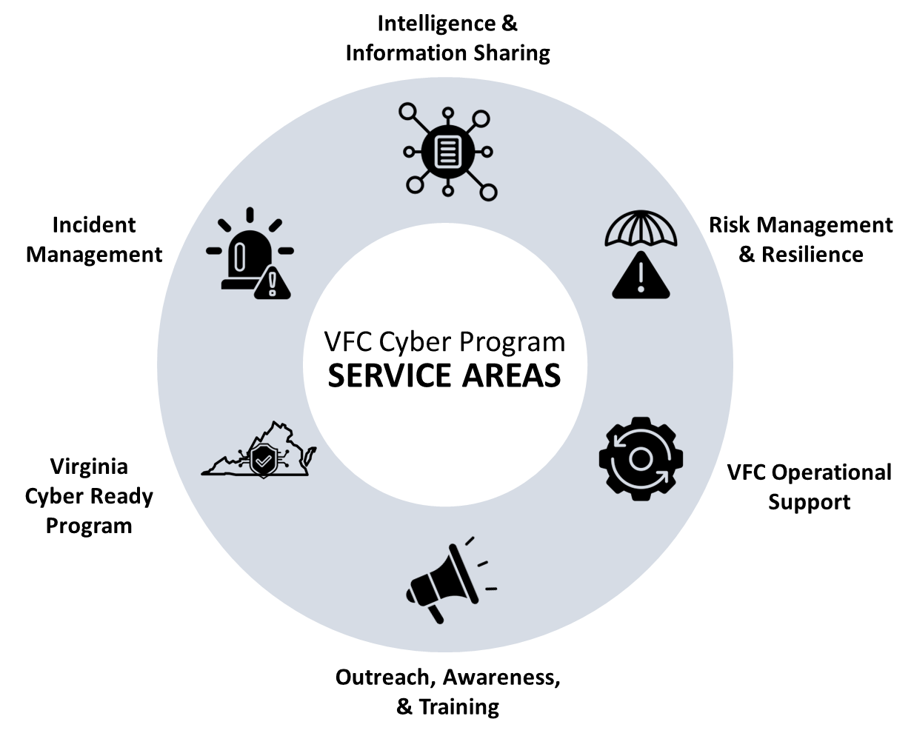
VFC Cyber Program
Critical Stakeholders
Critical Stakeholders represent priority areas for partnership, outreach, intelligence collection, & delivering products & services.
Virginia Nexus
State, Local & Municipal Government
K-12 Educational Institutions
Public Safety & Emergency Services
(Police/Fire/EMS/EM)
Critical Infrastructure *Rotating Top 3
Drive intelligence collection for these groups
Prioritize engagements with these groups
New ideas/projects should favor these groups

Slide 8

Risk Management & Resilience: Special Project - VAST
Description: Review public-facing infrastructure for SLTT entities and notify them of high risk issues/vulnerabilities – proactive work to reduce the likelihood of successful attacks.
Project Goal: Double stakeholders onboarded.
Working to better formalize this capability during pilot:
Documenting internal procedures [complete]
Standardizing notifications [complete]
Establish improved baseline for alert thresholds [in progress]

Slide 9

Intelligence & Information Sharing Special Project: PISCES
Project Description: Platform for Intelligence Sharing and Cybersecurity Engagement Services (PISCES) – HSIN Community of Interest for Cyber
Re-building / re-branding HSIN Cyber COI (formerly SHIELD) [in progress]
Act as primary cyber product library for Virginia [in progress]
Aggregates intel products from multiple entities/sectors
Searchable
Increases engagement opportunities
Ability to virtually interface with VFC Cyber [complete]
Request assistance, submit RFI’s, ask questions, etc.
Develop into a “Virtual Fusion Center” concept for cyber

Slide 10
Risk Management & Resilience: Special Project – CIRP-in-a-Box
Description: Cyber Incident Response Plan-in-a-Box offers guidance, templates, and checklists for SLTT entities needing to develop an incident response plan from scratch or
Project Goal: Version 1.0 [complete] – tested with several local and state agencies. Workshopped at APCO/NENA conference.
Future work will include growth into a Cyber Annex (CAnnex) option:

Slide 11


VIRGINIA FUSION CENTER
Quarterly Cyber Meeting
INTELLIGENCE BRIEFING
03/27/25
U//FOUO

Slide 12



Today’s Topics
Incident Reporting Statistics
Recent Events
Q1 Cyber Intelligence Products
U//FOUO

Slide 13
July 1,2022:
VA Code§2.2-5514
Every public body shall report all (i) known incidents that threaten the security of the Commonwealth's data or communications or result in exposure of data protected by federal or state laws and (ii) other incidents compromising the security of the public body's information technology systems with the potential to cause major disruption to normal activities of the public body or other public bodies. Such reports shall be made to the Virginia Fusion Intelligence Center within 24 hours from when the incident was discovered. The Virginia Fusion Intelligence Center shall share such reports with the Chief Information Officer, as described in § 2.2-2005, or his designee at the Virginia Information Technologies Agency, promptly upon receipt.
U//FOUO

Slide 14


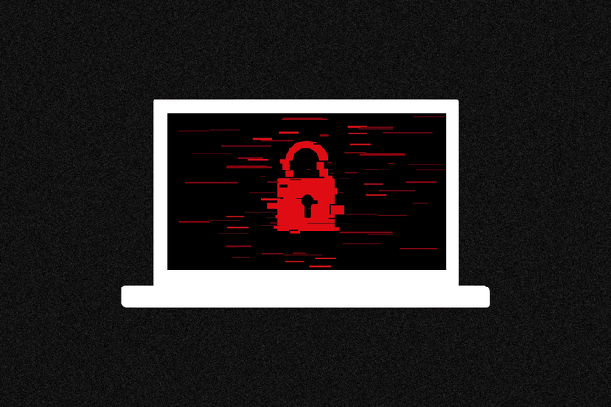
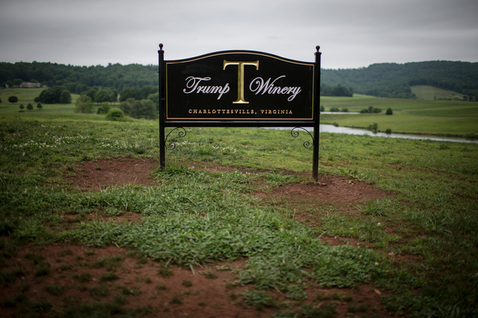
Recent Events
Oracle Cloud Breach
Fog Ransomware
Trump Winery DDoS Attacks
U//FOUO

Slide 15
Questions?
U//FOUO

Slide 16
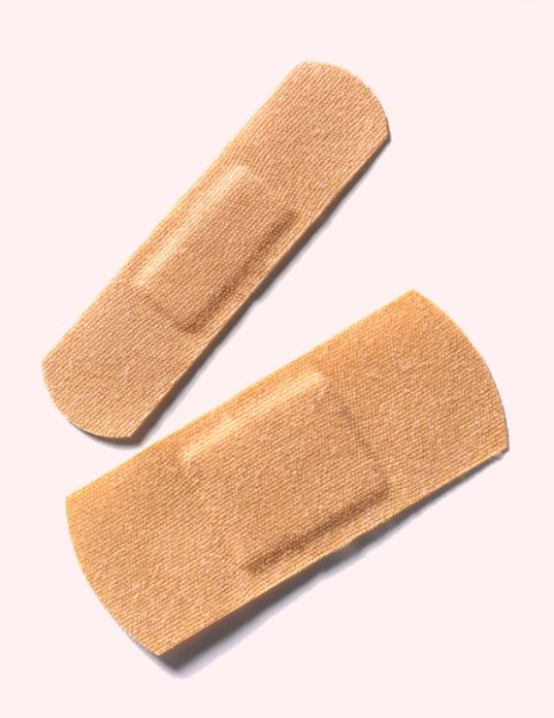
Server Vulnerability Compliant Patching Schedule
SEC530 30-Day ‘High’ and ‘Critical’ Compliance
John C Del Grosso
VITA SSDC Service Owner
Notes:
Title slide - Any text that looks black is HEX code 414042. If you have an idea for an image, let Atrayo or Nicolle know and we can provide you with one.

Slide 17
Agenda
Server Patching Process
Server Patching Window assignments
SEC530 Compliance Requirements
Prior Patch Schedule
New Patch Schedule

Slide 18
SEC520 Risk Management Requirement & SEC530 Information Security Standard Requirement
SEC520
4.7.2 Requirements
Fix vulnerabilities within 30 days of a fix becoming available that are either:
Rated as critical or high (CVSS V3 Score of 7-10) according to the National Vulnerability Database (VND)
Otherwise identified by CSRM
Remediate all other vulnerabilities within 90 days of a fix becoming available.
Acquire an approved security exception for the vulnerability should it not be remediated within the timeframes identified. Mitigating controls will be expected as part of this process.
SEC530
SI-2 FLAW REMEDIATION
Identify, report, and correct system flaws;
Test software and firmware updates related to flaw remediation for effectiveness and potential side effects before installation;
Install security-relevant software and firmware updates within at least 30 days or within a timeframe approved by Commonwealth Security and Risk Management of the release of the updates; and
Incorporate flaw remediation into the organizational configuration management process.

Slide 19
Patching Processes
Patching Processes
Patching is a continual activity which is done weekly, even to some degree, daily, depending on application ownership and VITA/Supplier responsibility.
Most patching by Unisys is automated using the Ivanti Management System with no manual intervention. The Ivanti system reports the patch results, any issues or failures are investigated by the SSDC patch team and rectified either manually or a re-patch from Ivanti is completed until successful.
Manual patching is accomplished for Oracle-based Operating Systems and Applications or other situations where servers did not ‘take’ the patch from Ivanti.
Suppliers have support responsibility for applications, as listed in the ESSP (Enterprise Software Security Patching List.

Slide 20
Patching Window Assignments
Unisys schedules “Patch Windows” initially when servers are placed into production
A specific patching window can be requested when a server is requested (Service Catalog) or
Patching window can be assigned/modified via Service Request (indicate servername and preferred patch cycle)
Push & Stage: Agency can request that patches are staged (pushed) on the server but not initiated automatically. The Agency can either reboot the server themselves to start and complete the patching –or- request that Unisys initiate the reboot via Service Request
Push & Reboot: Server will be rebooted when patches are applied, as necessary,
Patch cycles are based on Microsoft Patch Tuesday, when all Microsoft, Adobe and other patches are released.
Linux/RHEL patches are released through the month – generally every one or two weeks based on patch type
In most months, patching occurs in the middle or second half of the month as Patch Tuesday occurs between the 8th and 14th, nearly halfway into the month.

Slide 21
VITA/Unisys Patch Window Details (Current State)
Patch Window (in CMBD) | Server Count | Day and Time of Patch Window | Comments
Window A: Pilot Group | 192 | 1st Sunday after MS Patch Tuesday. 3AM to 9AM. Success and operational impact of patch(es) assessed over the week. | Prod, Test, and Dev servers. A one-week observation and verification before the next Patch Window.
Window B: Dev & Test | 846 | 2nd Sunday after MS Patch Tuesday. 3AM to 9AM | Test and Dev are done first, then Prod. Provides for final check before releasing to entire environment.
Window C: Storage & Backup | 15 | 2nd Tuesday after MS Patch Tuesday. 10AM to 3PM | Nearly all of these are Unisys production Storage and Backup servers that are done during the day (backups happen at night).
Window D: Dev & Test | 65 | 2nd Wednesday after MS Patch Tuesday. 7PM to Midnight | Nearly all Prod belong to Agencies.
Window E: Production Servers | 1871 | 3rd Sunday after MS Patch Tuesday. 3AM to 1PM | This is the full patching for 50% of the population, three weeks after all patches have been tested, verified considered safe for release.
Window X: Storage and Back-up Production | 29 | 3rd Tuesday after MS Patch Tuesday. 10AM to 3PM | This date is scheduled for AIX servers and Unisys servers. Reserved as a catch-up from Windows B, C, and D.
Window F: Production | 68 | 3rd Wednesday after MS Patch Tuesday. 7PM to Midnight | Also reserved as a catch-up from Windows B, C, and D
No Patch Window indicated | 527 | These are done throughout the month independent of the MS Patch Tuesday schedule. | Generally, Agencies/Suppliers who opt to self-patch or to Stage and self-restart or devices that must be manually patched (e.g. Oracle).

Slide 22
Patch Calendar – Current State (Example: March)
Monday | Tuesday | Wednesday | Thursday | Friday | Saturday | Sunday
25 | 26 Patch “X” | 27 Patch “F” | 28 | 29 | 30 | 1
2 | 3 | 4 | 5 | 6 | 7 | 8
9 | 10 | 11 | 12 | 13 | 14 | 15 Patch “A”
16 | 17 | 18 | 19 | 20 | 21 | 22 Patch “B”
23 | 24 Patch “C” | 25 Patch “D” | 26 | 27 | 28 | 29 Patch “E”
30 | 31 Patch “X” | 1 Patch “F” | 2 April | 3 April | 4 April | 5 April
Microsoft Patch Tuesday

Slide 23
Future State of Patching

Slide 24
Revised patch schedule – starts April 2025
Patching schedules will be as follows:
Days A and B will be combined into the Sunday pilot window
Day D will be moved to the Wednesday pilot window
Day E will be Production Sunday window
Day F will be Production Wednesday
Days C and X will remain at their current times
 | Sundays | Tuesdays | Wednesdays
Pilot patching | 3:00 am – 9:00 am | 10:00 am – 3:00 pm | 7:00pm – Midnight
Production patching | 3:00 am – 1:00 pm | 10:00 am – 3:00 pm | 7:00pm - Midnight

Slide 25
Patch schedule beginning in April
Patch released between | Pilot windows | Production windows
March 30 – April 12 | Sunday, April 13 | Sunday, April 20
 | Tuesday, April 15 | Tuesday, April 22
 | Wednesday, April 16 | Wednesday, April 23
April 13- April 26 | Sunday, April 27 | Sunday, May 4
 | Tuesday, April 29 | Tuesday, May 6
 | Wednesday, April 30 | Wednesday, May 7
April 27 – May 17 | Sunday, May 18 | Sunday, May 25
 | Tuesday, May 20 | Tuesday, May 27
 | Wednesday, May 21 | Wednesday, May 28

Slide 26
Patch Calendar – Future State (Start: April 2025)
Monday | Tuesday | Wednesday | Thursday | Friday | Saturday | Sunday
30/31 March | 1 April | 2 | 3 | 4 | 5 | 6
7 | 8 | 9 | 10 | 11 | 12 | 13
14 | 15 | 16 | 17 | 18 | 19 | 20
21 | 22 | 23 | 24 | 25 | 26 | 27
28 | 29 | 30 | 1 May | 2 | 3 | 4
5 | 6 | 7 | 8 | 9 | 10 | 11
Patch Release from OEM
Microsoft Patch Tuesday
Pilot
A
B
Patch Release from OEM
Pilot
Pilot
Production
D
E
Patch Leased from OEM
Black-out/Freeze Rescheduling
Production
Production
Pilot
C
F
A
B
Patch Leased from OEM
Pilot
Pilot
Production
X
D
E
Production
Production
C
F

Slide 27
Primary Differences from Past to Future Patching Cycles
Monthly Patching Cycles
Past: Patch Cycles planning over a month (30-day period)
Future: Patch Cycles planned over a 2-week period, with two patch cycles per month
Reduction of time duration between Pilot (Dev/Test) and Production
Past: a two-week patch checkout and test cycle before applying to Production
Future: a one-week patch checkout and test cycle before applying to Production
Blackout / Change Freeze re-scheduling
Past: In general, if the affected patch window fell on a freeze date, the patch would be pushed to the next month
Future: Servers affected by freeze are pushed to next patch cycle within the same month or the next months first cycle
Security Exceptions for patch outside the 30-day window
Past: Generally, with a 60 or 90-day requirement, the patch was applied within the time requirement, negated need for Exception
Future: Agencies that push or delay patching beyond 30-day cycle must submit a Security Exception for the specific servers

Slide 28
Common Questions with Answers
How can agencies adjust the window their servers are patched in?
Agencies can view their server patch window through the Pilot & patching tab of the AITR dashboard. Submit a general service request to adjust a server patching window. Indicate the server, the current patch window and the desired patch window.
How can agencies ensure servers are only patched during a specific time window, such as Sunday’s patch day?
Specified with Ivanti and noted in the CMDB – patching outside of the specified window should not be happening unless the agency specifically requests for a patch window adjustment.
When does my agency require a security exception for vulnerability patching?
If the high or critical patch cannot be applied within the 30-day requirement.
In a patch change freeze or blackout, how does my server get re-scheduled?
The server(s) will be pushed to the next patch cycle within the same month or the first patch cycle in the following month (ensuring 30-day compliance)

Slide 29
Questions? Thank you!
Notes:
This slide is used as a transition title slide for a new section

Slide 30
Cyber Vault Service (CVS)
IMAGE
John Del Grosso
Service Owner
Notes:
No

Slide 31
Agenda
Compliance to Commonwealth of Virginia (COV) standards
Overview
Use of a vault
The air gap
Threat detection and notification
Availability

Slide 32
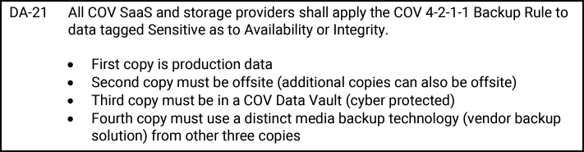
Compliance to standards
Enterprise architecture (EA) 225
All data assets tagged with “sensitive as to availability or integrity” in the system of record shall be protected by a COV data vault per EA 225 guideline DA-38
Cyber vault service (CVS) qualifies as a cyber resilient backup service per EA 225 policy guidelines DA-43 through DA-53
CVS is the third leg of the COV 4-2-1-1 backup rule for sensitive data
SEC530
CVS can be used for contingency planning and adheres to SEC530 CP-2

Slide 33
Benefits and use cases
Cyber vault service (CVS) will allow agencies to maintain mission-critical business data and technology configurations in a secure, air gapped vault that can be used for data recovery from the last non-infected dataset saved
Enable long-term archiving of sensitive information for business continuity
Isolates essential systems from potential cyber threats
Safeguard citizen data, including personal identification details
Data recovery from ransomware and cyber attack(s)

Slide 34
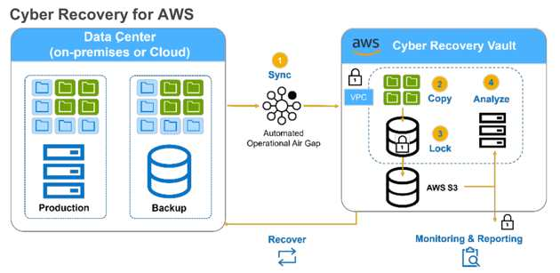
How it works
Air gap: The air gap is a logical separation between the QTS data center and Amazon Web Services (AWS) to ensure their isolation from each other where ports are de-activated to prevent unauthorized access.
Vaulting cadence: Data sets are retained up to 14 days in CVS and can be refreshed by the agency after the daily backup. The vaulting cadence is determined by the agency during implementation.
Notification: Subscribing agencies will be notified for various syslog (system logging) activity within the vault via email. Logs are stored by security information and event management (SEIM) in Splunk.

Slide 35
Questions about vaulting
Question | Answer
Does the vault support database backups? If so, does it back up just the data or the entire server? | The cyber recovery vault captures database backups as file system dumps, which are then included in the nightly full server backup. This ensures that the entire server is backed up, not just the database.
What level of access does the agency have to the vault? Can they retrieve their data? | Agencies do not have direct access to the vault, as it serves as a secure, immutable backup environment. However, reports can be generated to view the vaulted data and servers.
Can the vault be used for server recovery? | No, the cyber recovery vault is not designed for direct server recovery. Instead, recovery must be performed using Dell’s Avamar services.
Is the data stored in the vault a full or partial backup? | The vault retains full backups, incorporating all prior incremental backups from nightly snapshots.

Slide 36
Ordering and costs
Now available in the VITA service catalog
Chargeback costs:
Chargeback RU name | Chargeback rate | Unit of measure
Agency implementation | $1,232.00 | One-time
Application protection | $456.00 | Per protected application, one-time
Server protection | $236.00 | Per protected server, one-time
Agency cyber vault support | $736.75 | Per month
Application cyber vault support | $64.00 | Per protected application
Server cyber vault support | $45.95 | Per protected server
Note: There may be additional one-time labor costs for vaulting

Slide 37


t
Questions?
vita.virginia.gov

Slide 38

Announcements
ISOAG April 2, 2025
Notes:
Example of when to use this slide background for a call out section and text

Slide 39



Two New Types of User Guides!
There are three new types of user guides available on CSRM Connections:
Hey ISOs! The Archer and Nucleus guides are now published on the CSRM Connections! View the guides today on CSRM Connections (Under the “ISO Resources” link on the right side) Strengthen your agency’s security with ease! 🔐
Learn how to:
✅Access & analyze vulnerabilities
✅Prioritize risks effectively
✅Streamline workflows & boost security
vita.virginia.gov
Notes:
This slide background works best with text heavy sections, with no imagery OR when an Icon is used

Slide 40




SPLUNK UPDATE – Spring Into Action: Get Your Logs Blooming!
Spring has sprung, so be sure to send in your logs, right into the VITA Splunk instance! Just like pollen in the air (but way less annoying), your logs should be flowing freely. VITA is here to help bring your application logs into Splunk, giving you fresh insights and stronger security. We’re always happy to hop on a call (no bunny suit required) to discuss your options and make sure everything is ready to grow. Let’s make your logs blossom this spring – minus the allergies!
Notes:
Example of when to use this slide background for a call out section and text

Slide 41


Top 5 Vulnerabilities
For the Month of April, the Top 5 Key Vulnerabilities are:
IBM HTTP Server 8.5.0.0<8.5.5.26/9.0.0.0<9.0.5.18 DoS (7129933) KB4025339: Windows 10 Version 1607 and Windows Server 2016 July 2017 Cumulative Update Splunk Enterprise 9.0.0<9.0.9, 9.1.0<9.1.4, 9.2.0<9.2.1 (SVD-2024-0718) SSL RC4 Cipher Suites Supported (Bar Mitzvah) Jenkins LTS<2.452.4/Jenkins weekly<2.471 Multiple Vulnerabilities
vita.virginia.gov
Notes:
This slide background works best with text heavy sections, with no imagery OR when an Icon is used

Slide 42
Upcoming Events
vita.virginia.gov
Notes:
This slide is used as a transition title slide for a new section

Slide 43

Service Tower SOC Report Review Sessions
To register for this meeting, please click on the link below:
https://covaconf.webex.com/weblink/register/r114f684dbdf1015aa82eaa3f39d24e67
The upcoming SOC review session is June 12, 2025, and will be held remotely.
Please register at the link below
Notes:
Example of when to use this slide background for a call out section and text

Slide 44

IS Orientation
CISO: CHIEF INFORMATION SECURITY OFFICER, MICHAEL WATSON
The next IS Orientation is being held on June 25, 2025
June 25, 2025, from 9am to 4pm, registration closes June 18th.
It will be held in-person at the Boulders location:
7325 Beaufont Springs Drive, Richmond, VA 23225
Visit Commonwealth IS Orientation to register!
Examples of FOIA Requests
Notes:
This slide works best with photos and graphs/charts. Image and text can be reversed

Slide 45



CISO: CHIEF INFORMATION SECURITY OFFICER, MICHAEL WATSON
Government Cybersecurity Showcase Virginia
Elevating Virginia’s Digital Defense
Examples of FOIA Requests
Public Sector Network is presenting: Government Cybersecurity Showcase Virginia
Held on Wednesday, April 9, 2025, at the Downtown Richmond Marriott
The registration link is below:
Public Sector Network » Event - Government Cybersecurity Showcase Virginia
Notes:
This slide works best with photos and graphs/charts. Image and text can be reversed

Slide 46

Commonwealth of Virginia Information Security Conference 2025
CISO: CHIEF INFORMATION SECURITY OFFICER, MICHAEL WATSON
Future-Proofing Cybersecurity:
Next-Gen Strategies
August 14, 2025
Hilton Richmond Hotel, 12042 West
Broad St., Richmond, VA 23233
Registration will open soon!
Notes:
This slide works best with photos and graphs/charts. Image and text can be reversed

Slide 47
MEETING ADJOURNED
Notes:
Title slide - Any text that looks black is HEX code 414042. If you have an idea for an image, let me know and I can provide you with one.

